Slide 1
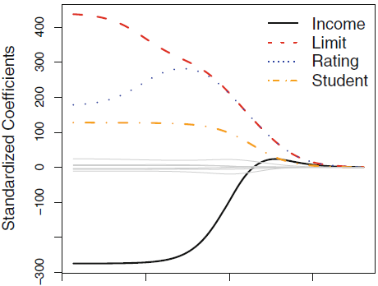

RIDGE REGRESSION
Recall the dataset on loan defaults
predict whether an individual will default on their credit card payment
using annual income, student status, credit limit, and monthly credit rating
Important to use standardized dataset
represent the linear regression coefficients on the standardized data
High flexibility
Low flexibility
$$λ$$
0 0.01 100 10000
Notes:
Recall the dataset on loan defaults; we were interested in predicting whether an individual will default on their credit card payment, using data on annual income, student status, credit limit, and monthly credit rating. We use a standardized version of that dataset.
Recall standardized data is data where we subtract the mean and divide by the standard deviation
Standardization makes all variables on the same scale, so coefficients for larger scale variables don’t get a higher penalty
e.g. income in dollars would have a larger coefficient and therefore a larger penalty than income in cents, which makes no sense
The green circles represent the linear regression coefficients on the standardized data

Slide 2
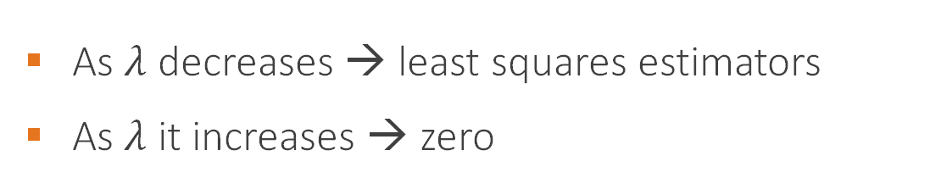
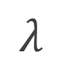
RIDGE REGRESSION
As $λ$ decreases → least squares estimators
As $λ$ it increases → zero
High flexibility
Low flexibility
$$λ$$
0 0.01 100 10000
Notes:
The figure shows the relationship between $λ$ and the coefficient estimators for the standardized data
As $λ$ decreases, the estimators converge to least squares estimators; as it increases, the model fitting process favors smaller estimators, and thus shrinks them towards zero

Slide 3
2) Now we try out our different model selection algorithms
R Code
Best model selection in all possible models
xydatReg <- regsubsets(y~., data=xydat, method=“exhaustive”, nvmax=10)
xydatRegF <-regsubsets(y~., data=xydat, method="forward", nvmax=10)
xydatRegB <- regsubsets(y~., data=xydat, method="backward", nvmax=10)
xydatRegS <- regsubsets(y~., data=xydat, method="seqrep", nvmax=10)
Forward selection
backward selection
Stepwise selection
Only deleted this stepwise part
Python Code
models = bestModel(y, X, 11)
models = forward_stepwise(y, X)
models = backward_stepwise(y, X)
Best model selection in all possible models
⬇ In the Python code, we pre-defined the functions for model selection so now we have nice compact code
Forward selection
Backward selection

Slide 4
Exercises: College Applications
Compare results from the linear model, ridge regression, the lasso, PCR, and PLS
Predict the number of college applications accepted
Dataset: 777 observations on 18 variables
Variables:
college is public or private
number of applications received
number of applications accepted
number of new students enrolled
percentage new students from top 10% of high school class
percentage new students from top 25% of high school class
number of full undergraduates
number of part-time undergraduates
out-of-state tuition
room and board costs
estimated book costs
estimated personal spending
percentage of faculty with Ph.D.’s
percentage of faculty with terminal degree
student/faculty ratio
percentage alumni who donate
instructional expenditure per student
graduation rate

Slide 5
Exercises: College Applications
1) For this exercise, we will fit each of the models discussed in this section and compare their resulting performances in terms of ability to predict number of applications:
R Code
CollegeLM<-lm(Accept~.,data=train2)
CollegeLMPred<-predict(CollegeLM,test2,type="response")
ColRidge<-glmnet(train2M,train2$Accept,alpha=0,lambda=lambdas3)
ColRidgeCV<-cv.glmnet(train2M,train2$Accept,alpha=0,lambda=lambdas3)
ColRidgePred<-predict(ColRidge,s=ColRidgeCV$lambda.min,newx=test2M)
Linear model & its prediction
Ridge regression & its prediction
Python Code
linreg = linear_model.LinearRegression()
linreg.fit(X, y)
print("test MSE of LR: " + str(((linreg.predict(X_test) - y_test) ** 2).sum()/len(y_test)))
ridge = linear_model.Ridge(fit_intercept=True, normalize=True)
ridge.set_params(alpha = minLambda)
ridge.fit(X, y)
print("test MSE of ridge with lambda {}: {}".format(str(minLambda), str(((ridge.predict(X_test) - y_test) ** 2).sum()/len(y_test))))
Calling the linear model then fitting it
Model prediction and associated MSE
Calling the ridge regression, then fitting it using the CV best parameter
Model prediction and associated MSE

Slide 6
Exercises: College Applications
1) For this exercise, we will fit each of the models discussed in this section and compare their resulting performances in terms of ability to predict number of applications:
R Code
ColLasso<-glmnet(train2M,train2$Accept,alpha=1,lambda=lambdas3)
ColLassoCV<-cv.glmnet(train2M,train2$Accept,alpha=1,lambda=lambdas3)
ColLassoPred<-predict(ColLasso,s=ColLassoCV$lambda.min,newx=test2M)
ColPCR<-pcr(Accept~., data=train2,scale=TRUE,validation="CV")
ColPCRPred=predict(ColPCR,test2,ncomp=16)
Lasso & its prediction
PCR & its prediction
Python Code
Calling the lasso then fitting it
lasso = linear_model.Lasso(fit_intercept=True, normalize=True)
lasso.set_params(alpha = minLambda)
lasso.fit(X, y)
print("test MSE of lasso with lambda {}: {}".format(str(minLambda), str(((lasso.predict(X_test) - y_test) ** 2).sum()/len(y_test))))
pcr = linear_model.LinearRegression()
pcr.fit(X_pca_train, y)
print("test MSE of PCR with {} components: {}".format(str(minM), str( mean_squared_error(pcr.predict(X_pca_test), y_test) )))
⬇ In the Python code, note how PCR is fit like a linear model; the only difference is that we first transform the data using PCA before fitting the model
Calling the PCR then fitting it

Slide 7
Exercises: College Applications
1) For this exercise, we will fit each of the models discussed in this section and compare their resulting performances in terms of ability to predict number of applications:
R Code
ColPLS<-plsr(Accept~., data=train2,scale=TRUE,validation="CV")
ColPLSPred=predict(ColPLS,test2,ncomp=7)
colMeans((cbind(CollegeLMPred, ColRidgePred, ColLassoPred, ColPLSPred, ColPCRPred)-test2$Accept)^2)
PLS & its prediction
MSE comparison
Python Code
Calling the PLS then fitting it
pls = PLSRegression(n_components = minM)
pls.fit(X_scale_train, y)
print("test MSE of PLS with {} components: {}".format(str(minM), str( mean_squared_error(pls.predict(X_scale_test), y_test) )))
Predicting values and computing MSE for PLS

Slide 8
Exercises: Predicting Crime Rates
Use the methods from this section to predict the crime rate in different towns.
Dataset: 506 observations and 14 variables
Variables:
per capita crime rate by town
proportion of residential land zoned for lots over 25,000sq.ft
proportion of non-retail business acres per town
Charles River tract bounds
nitrogen oxides concentration
average number of rooms per dwelling
proportion of owner-occupied units built prior to 1940
weighted mean of distances to five Boston employment centers
index of accessibility to radial highways
full-value property-tax rate per $10,000
pupil-teacher ratio by town
African American proportion by town, scaled
proportion of adults without some high school education
proportion of male workers classified as laborers
median value of owner-occupied homes in $1000s

